Slide 1
Help People GROW LEAN 2019
10/8/2019

Slide 2
What we’re going to do
Introductions
Warm-up instruction
Warm-up practice
GROW instruction
GROW practice! Very serious.
Wrap up

Slide 3
What is Thrive At Work?
We’re an organizational development company dedicated to making work a better experience for everyone involved.
To that end we do workshops, classes, consulting, coaching, research and invent tools.
Our partners include a scientist, a management expert, and a wellness/career coach.
We’re human-centered! Heck yes!

Slide 4
Dr. Damon Drown, Chief Scientist
Passionate about helping people get better information through research
Was head of Leadership Evaluation at Microsoft and on the leadership research team at Amazon
Before that he was a professor at Portland State University
Just had a baby girl!
Notes:
Damon. Passionate about changing the way people look at leadership

Slide 5
Doric Olson
Passionate about helping teams work better together
Was an executive manager at L&I from 2008-2017
2013 recipient of the Governor’s Award for Leadership in Management
Loves sword fighting. Look out!

Slide 6
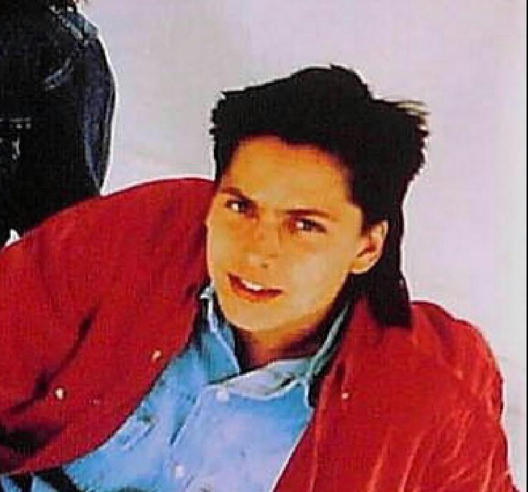
John Utter
Passionate about personal growth and development
Career & wellness consultant/coach
Wrote career guide in Al Gore’s National Performance Review
Had a big record deal with a group called Bounce The Ocean – and a wicked mullet!
Notes:
Conflictedness in music industry

Slide 7
Session Overview
The most consistent complaint we hear when someone is upset in the workplace is “They don’t care” and “They don’t listen”.
Notes:
Should be here at about 2 minutes

Slide 8
Our Study
We did a quantitative study of over 1200 people internationally. It turns out that people need four basic things from their managers and people around them:
Competence support: Help getting the work done right
Belonging support: Being acknowledged, inclusion
Learning support: Shared growth & discovery
Embodiment: Integrity, responsibility, walk=talk
All of the above build trust in different ways.
Notes:
Judith Glaser and trust

Slide 9
Our Study & GROW Coaching
What we love about GROW is that it helps with all four of these needs.
GROW helps people embody their goals through a mutual process that builds competence, belonging, and learning for both parties.
When people truly embody their goals you can’t stop them. You don’t have to hold them accountable, they are self-accountable!
Notes:
Imagine a workplace where everyone was self-accountable.

Slide 10
Warm-Up Instructions

Slide 11
Warm-Up Instructions
We’re all going to practice coaching with each other in pairs
One person will be the coach and the other will be the learner
Your partner for the warm-up will be your partner for the rest of the session

Slide 12
Warm-Up Instructions
The coach will ask the learner, “What do you enjoy?”
The job of the coach, after asking the question, is to listen
The coach can ask some clarifying questions that invite the learner to get themselves across fully, such as:
“Clarify that”
“Repeat that”
“Expand on that” or “Tell me more”
“Summarize that”
Coaches please keep to the above questions for now
Notes:
Mention the spotlight effect. Do an example. It might not feel natural! You don’t need to ask the questions. If the person is getting themselves across, you don’t have to say anything.

Slide 13
Warm-Up Example

Slide 14
Warm Up Exercise. Let’s Do It!
The question is, “What do you enjoy?”
The Coaching questions are:
“Clarify that”
“Repeat that”
“Expand on that” or “Tell me more”
“Summarize that”
Please keep to the above questions for now
We’ll have about 1 minute for each person to share
Notes:
Mention the spotlight effect. Do an example

Slide 15
How Did the Warm Up Go?
What did your coaches do well in terms of helping you feel supported?
Coaches, how was it to stick with only clarifying questions?
Did anyone feel like they were able to really embody what they enjoy during that session?
Notes:
15 minutes.

Slide 16
Moving Forward
Coaches, your facial affect and posture – your actual interest in what your learners are saying is absolutely key to creating Belonging Support.
When we feel that bonding with another person then our brains produce oxytocin; a feel-good hormone that promotes well-being, longevity, and prepares us for optimal learning experiences.
That bonding, that Belonging Support is really crucial as a springboard for learning. This should help us as we move to GROW coaching.
Notes:
Our classes on Motivational Strengths and Psych Safety cover this in more detail. Now that we’ve boosted belonging support that should also boost our ability to learn

Slide 17
GROW Coaching Instruction

Slide 18
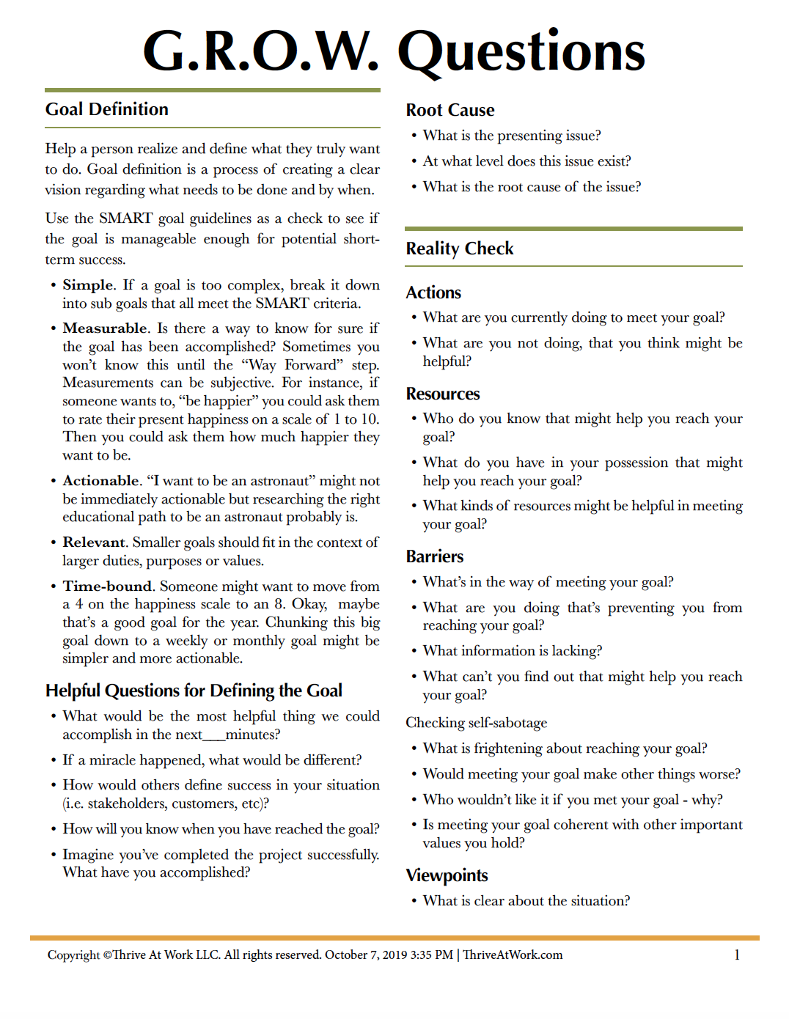
Your Coaching Tools
Sheet 1
Sheet 2
Notes:
Focus on Sheet 2 for workshop

Slide 19
Four Stages of GROW
GROW coaching is a little like our first exercise, and it provides a structure that guides the learner toward embodied action.
GROW coaching has four stages to it:
Goal: What do you want to accomplish?
Reality: What are existing pros and cons?
Options: What are potential ways forward?
Way Forward: A commitment to action
Notes:
About 20 minutes here

Slide 20
GROW Coaching Example
Notes:
Progress not protection

Slide 21
What Does the Coach do?
Mainly concerned with helping the learner explore what the learner knows
Asks open-ended questions that help guide the other person toward a solution they can embody
For these next GROW sessions, really avoid giving advice.
Instead, focus on asking the best questions
Keep the spotlight on the learner!
Notes:
Invite you to do an experiment. Use the questions on the worksheet.

Slide 22
GROW Is A Journey
GROW especially helps people & teams move through the unknown.
4. Embodiment
1. Competence Support
Known
3. Learning Support
2. Belonging Support
Unknown

Slide 23
GROW is Really Strong in the Unknown
Often no one really knows the best path forward, so it’s a matter of exploration to find the best path. The GROW process is a pathfinding process.
Our study taught us that people need to feel their leaders beside them, exploring with them.
Some support does come from people who know the answers. Of course. Awesome!

Slide 24
The GROW Coaching Exercise
Each of you will have 10 minutes to coach the other
When you’re coaching, intend to guide your partner to an embodied commitment using the questions supplied on your worksheets
Don’t worry too much if you don’t complete it
There’s value in every step of the GROW process

Slide 25
Your Turn!
Partners, choose who will be the coach first
Learners, decide on a challenge you’d like coaching on

Slide 26
Coaches, Remember...
Help the other person explore what they know
Use the worksheet liberally for questions!
Avoid advice giving
Keep the spotlight on the learner!
Notes:
Coaching should start at 25 minutes into presentation at the latest.

Slide 27
Congratulations! How’d it go?
What is your trust level with your partner?
In what ways did you feel supported?
Competence?
Belonging?
Learning?
Embodiment?
Notes:
45 minutes

Slide 28
Uses for GROW
Gemba Walks: Use GROW to learn about what’s going on and help others find the way forward
Coach anyone who works for you
Coach groups
Coach peers
Coach up the organizational hierarchy to managers & leaders

Slide 29
Continue your Journey!
Take a course
We offer a Building Resilient Teams certificate program.
Assess your Support IQ
Leadership assessment, Self assessment, Team assessment
Get custom training
We LOVE to doing custom workshops for teams!
We are creating a workplace where we can bring our humanity to work with us!
Visit www.thriveatwork.com/lean for presentation slides and pdf files of the materials

Slide 30
We Hope This Helped Make Your Work Better!

Slide 31
THANK YOU!! www.thriveatwork.com damon@thriveatwork.com john@thriveatwork.com doric@thriveatwork.com

